Slide 1
Flexible multitask computation in World Models
宁睿轩

Slide 2
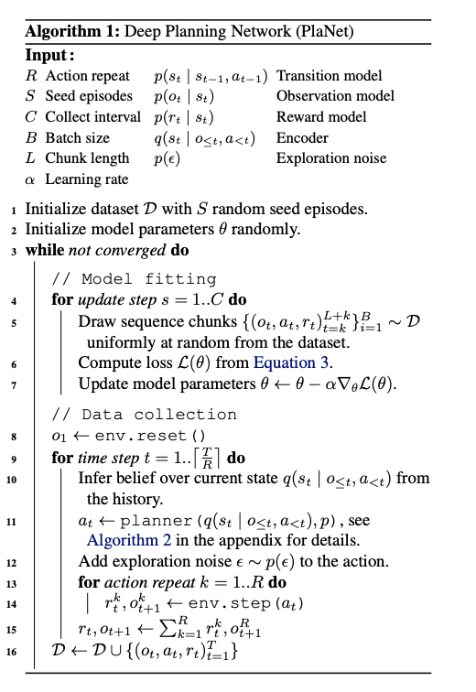

Model Overview
Hafner D, Lillicrap T, Fischer I, et al. Learning latent dynamics for planning from pixels[C]//International conference on machine learning. PMLR, 2019: 2555-2565.
Notes:
dreamer

Slide 3
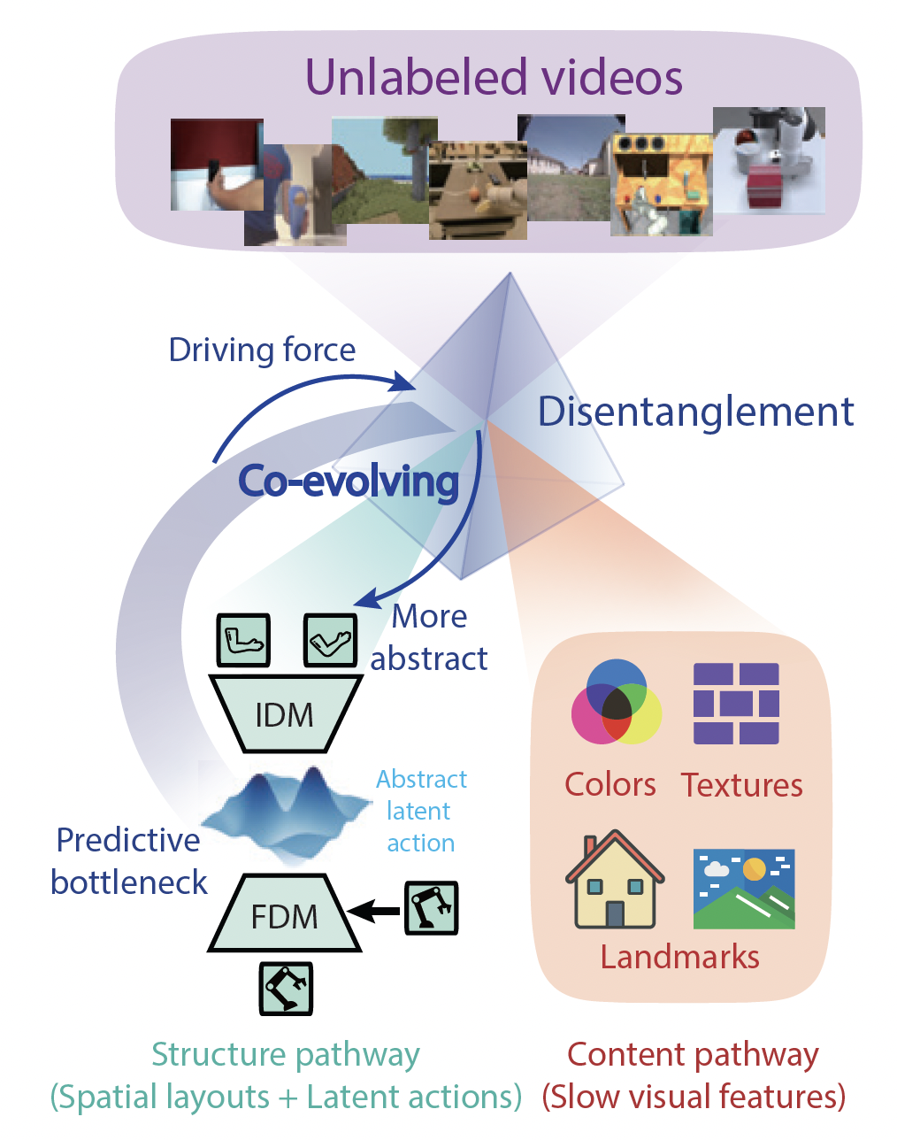
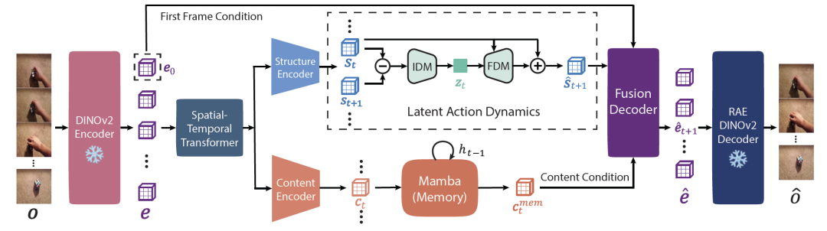
Model Overview
DiLA 将视频表征分成两条路径：
结构通路：负责建模与运动相关的空间结构，例如位置、形状、布局和动态变化。Latent action 只需要预测结构表征的变化，而不需要预测完整视觉特征。
内容通路：负责保存视觉细节，例如颜色、纹理、背景、物体外观和历史信息。
Zhang T, Lyu M, Zhang Y, et al. DiLA: Disentangled Latent Action World Models[J]. arXiv preprint arXiv:2605.15725, 2026.

Slide 4
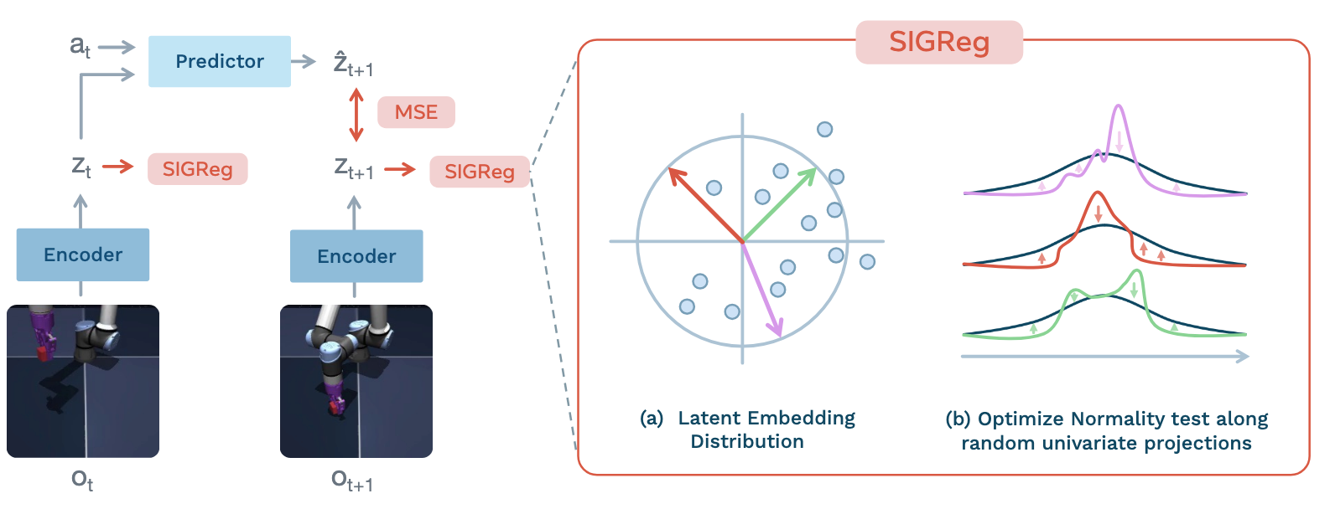
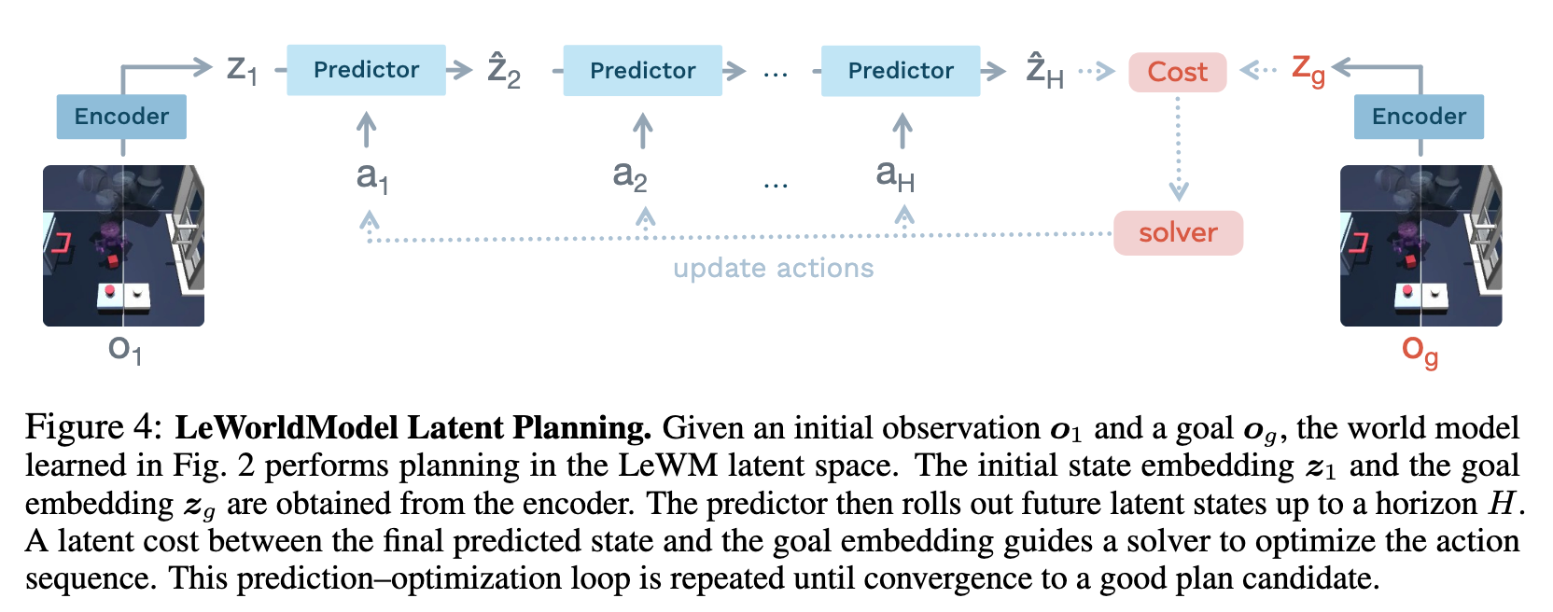
Model Overview
Maes L, Lidec Q L, Scieur D, et al. Leworldmodel: Stable end-to-end joint-embedding predictive architecture from pixels[J]. arXiv preprint arXiv:2603.19312, 2026.

Slide 5

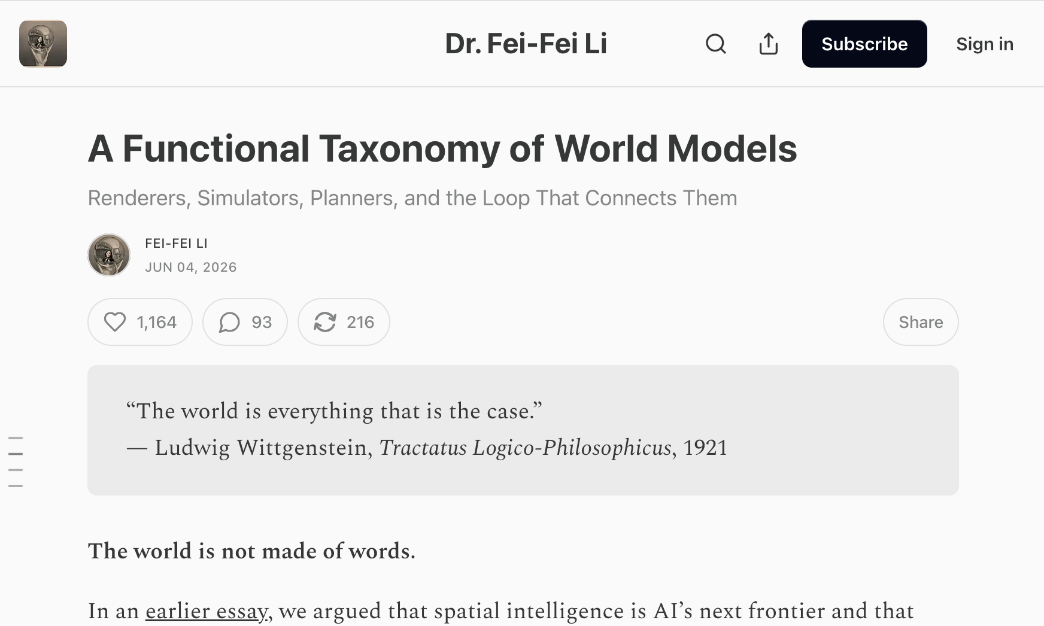
Model Overview
美国国家工程院院士、美国国家医学院院士、美国艺术与科学院院士，美国斯坦福大学首位红杉讲席教授，以人为本人工智能研究院（HAI）院长，AI4ALL联合创始人及主席，Twitter公司董事会独立董事，加拿大风险投资机构Radical Ventures科学合伙人。

Slide 6
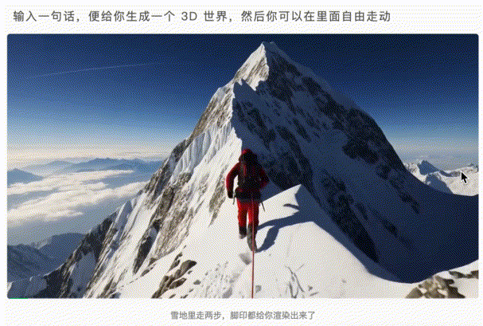
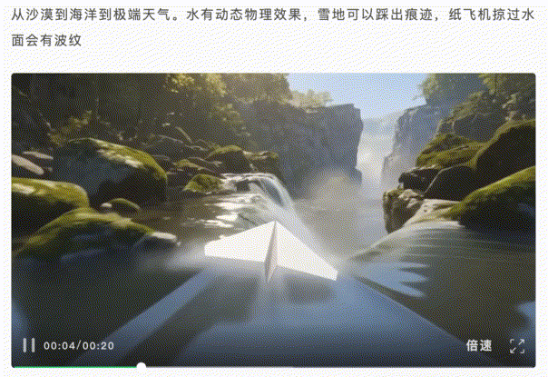
Model Overview
The first kind of world model is a renderer. A renderer outputs observations in the form of pixels meant for human eyes, and the quality that matters most is visual fidelity.
So is an interactive system like Google’s Genie 3, or World Labs’ own RTFM

Slide 7
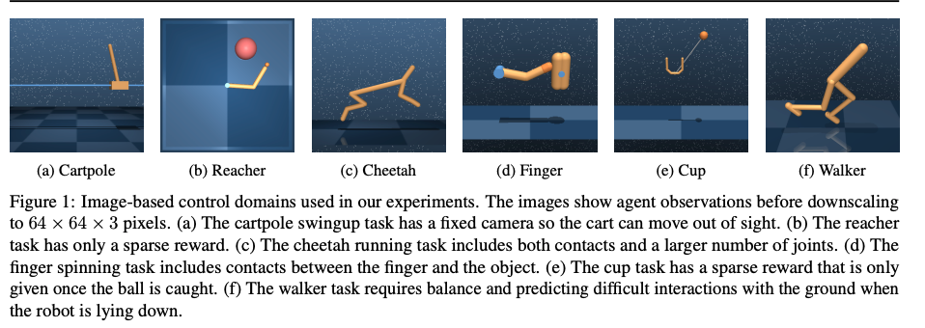
Model Overview
The second kind is a simulator. A simulator outputs state: a geometrically, physically or dynamically faithful representation of the world that humans and computer programs can both compute on and interact with.
Where the renderer’s contract is purely visual, the simulator’s contract is structural, demanding geometry that holds up under inspection, physics that respects Newton’s laws, and dynamics that behave the way the world needs to behave given the laws of physics.
Notes:
这部分像 simulator，因为它模拟“如果我做这个动作，未来 latent state 和 reward 会怎样”。

Slide 8
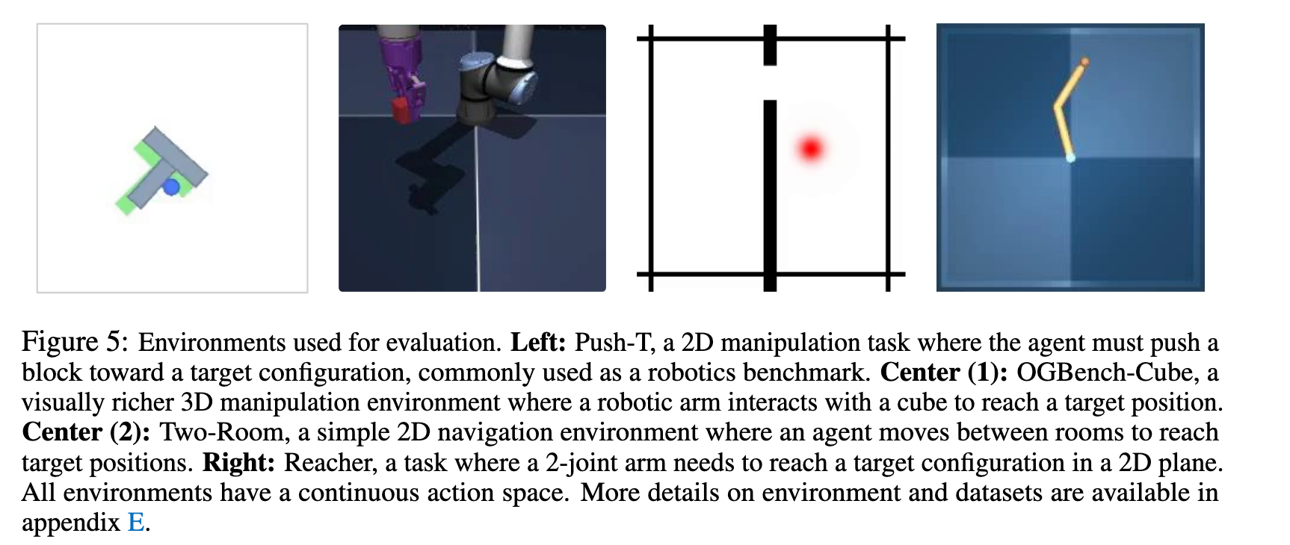
Model Overview
The third kind is a planner. A planner outputs actions.
Given an observation and a goal, a planner answers the question of what the agent should do next.

Slide 9
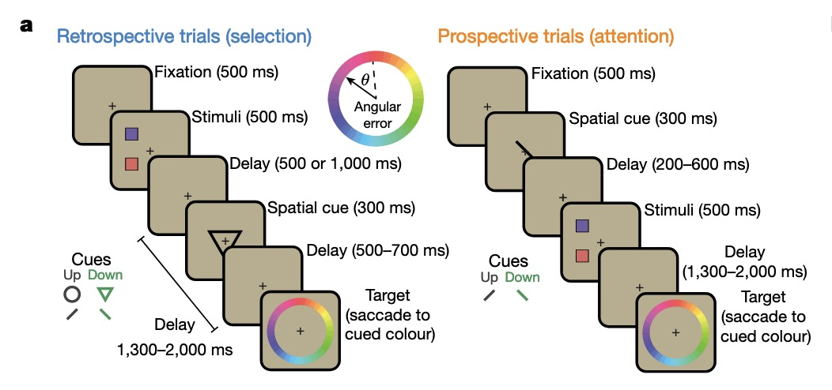
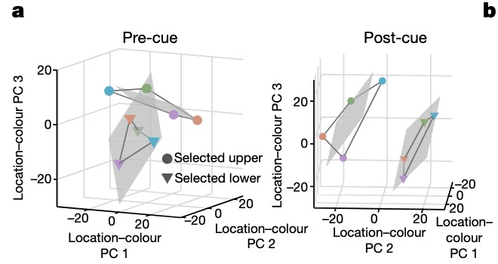
Analyze
1.First, a retrospective (“retro”) task required monkeys to select one of two items held in working memory
2.In addition, monkeys performed a prospective (“pro”) task.（focus：attention）
the upper and lower colour planes appeared to be independent from one another, suggesting that colour information about the upper and lower items was separated into two different item-specific subspaces in the LPFC population (before selection).

Slide 10
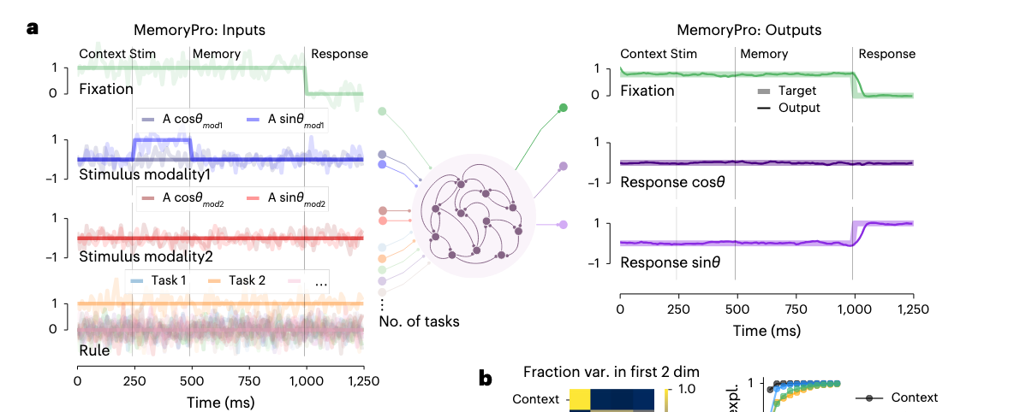
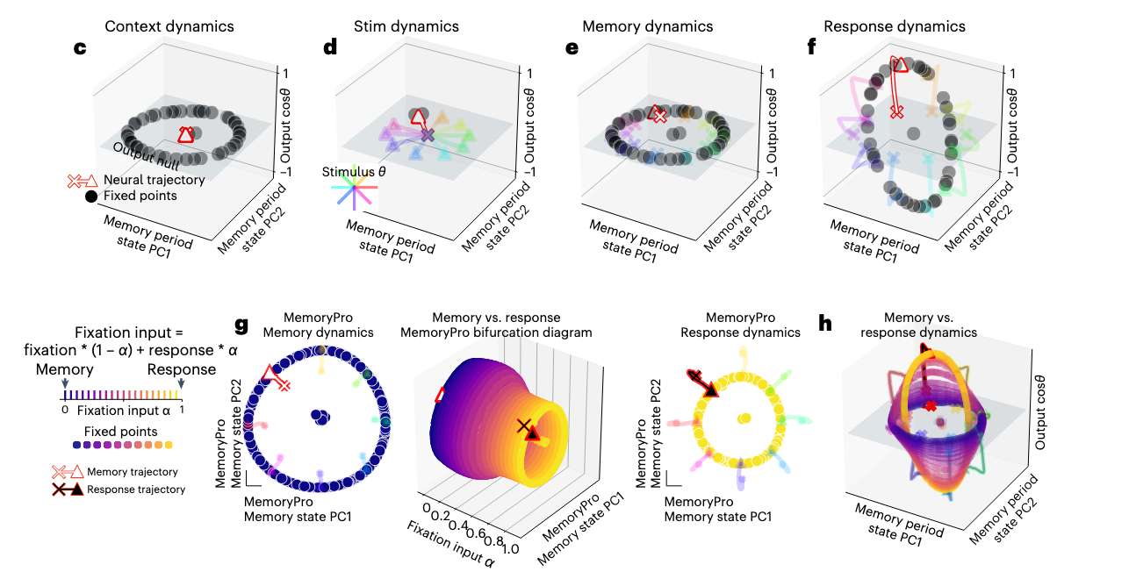
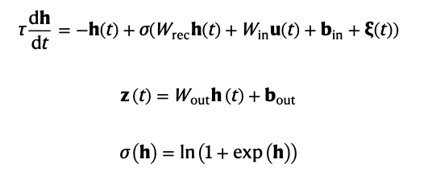
Analyze

Slide 11
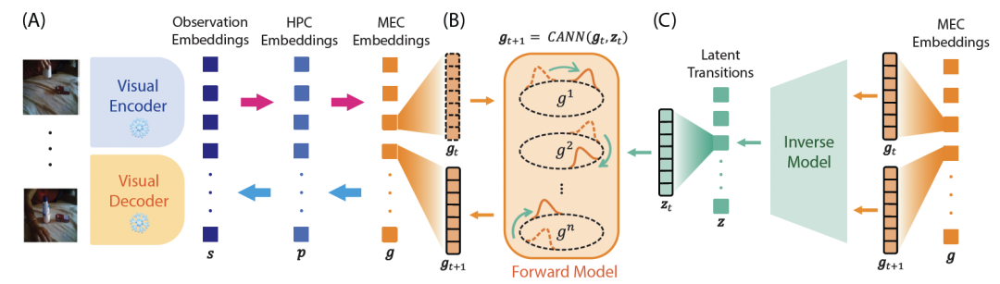
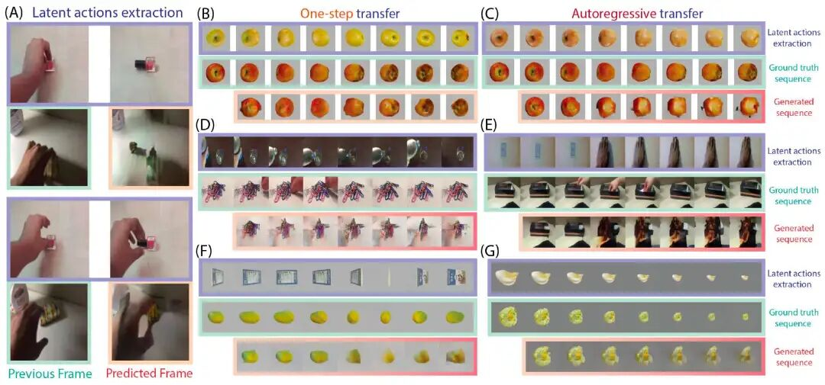
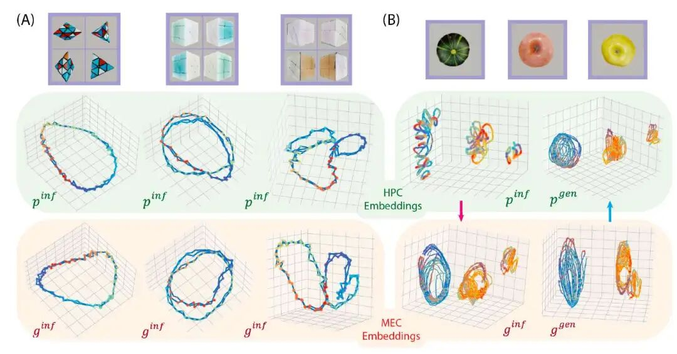
Analyze
Structure Abstraction and Generalization in a Hippocampus-Entorhinal Inspired World Model

Slide 12
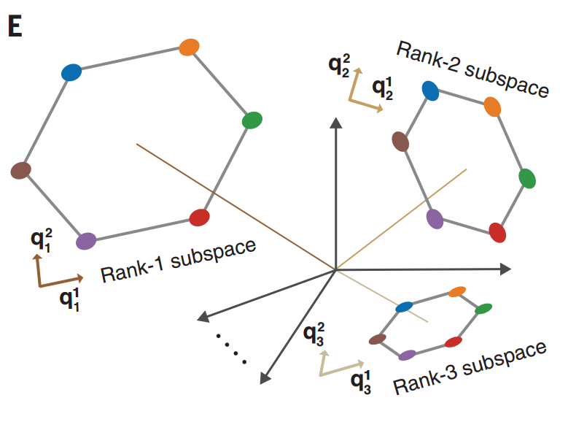
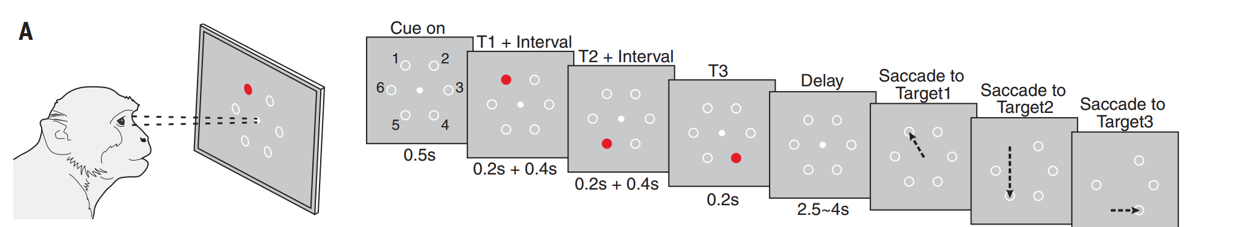
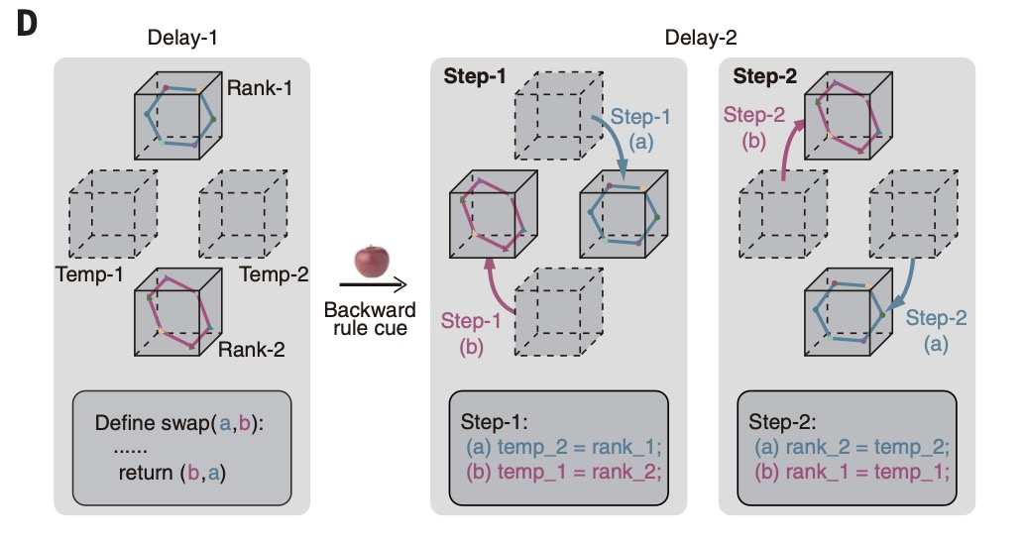
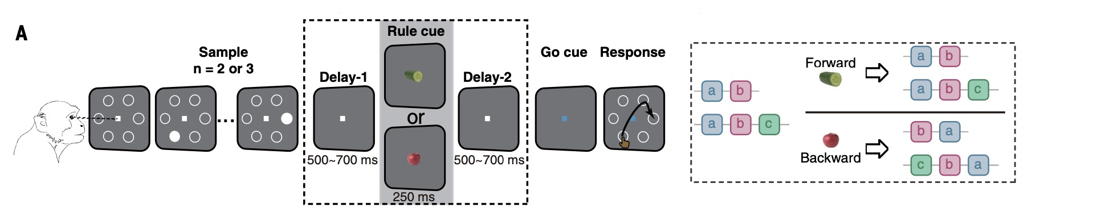
Analyze
2022， science
2024.9，science

Slide 13
Weakness
1. Limited scalability and architectural generality
Existing findings are largely based on small recurrent networks and highly controlled task families. It remains unclear whether similarly stable and interpretable shared structures emerge in larger, more heterogeneous multitask settings or in modern architectures such as Transformers and world models.
2. Task-supervised representations rather than predictive world models
Most studies train models on synthetic inputs with task-specific output supervision. As a result, schema is typically identified as a representation that supports particular behavioral readouts, rather than as an internal model that predicts latent state transitions, future observations, or the consequences of actions.
3. Limited evidence for functional utility and systematic generalization
Shared low-dimensional structures are often identified retrospectively through dimensionality reduction or decoding analyses. However, it remains unclear whether these structures causally support few-shot transfer, compositional generalization, continual learning, or planning in unseen task combinations.
Notes:
1. 有限的可扩展性与架构普适性
现有发现主要基于小规模循环网络和高度受控的任务族。目前仍不清楚，在更大规模、更异质的多任务设置中，或在 Transformer 与世界模型等现代架构中，是否也会涌现出类似稳定且可解释的共享结构。
2. 任务监督表征，而非预测式世界模型
大多数研究使用合成输入，并通过任务特定的输出监督来训练模型。因此，图式通常被识别为一种支持特定行为读出的表征，而不是一种能够预测潜在状态转移、未来观察或动作后果的内部模型。
3. 对功能效用和系统性泛化的证据有限
共享的低维结构往往是在事后通过降维或解码分析被识别出来。然而，目前仍不清楚这些结构是否因果地支持少样本迁移、组合式泛化、持续学习，或在未见过的任务组合中的规划。

Slide 14
Question
1.Can interpretable world models reveal how cognitive schemas support prediction across tasks?
2.Can a schema be defined as a reusable latent structure that supports prediction across different tasks or contexts?
3.If a model must predict future observations, does schema become useful because it compresses task structure and improves prediction?
4.How can we identify, visualize, and test schema-like structures inside a learned world model?
Notes:
1. 可解释的世界模型能否揭示认知图式如何支持跨任务预测？
2. 图式能否被定义为一种可复用的潜在结构，用于支持不同任务或情境下的预测？
3. 如果模型必须预测未来观察，那么图式是否会因为能够压缩任务结构并提升预测能力而变得有用？
4. 我们如何在一个已学习的世界模型内部识别、可视化并检验类图式结构？

Slide 15
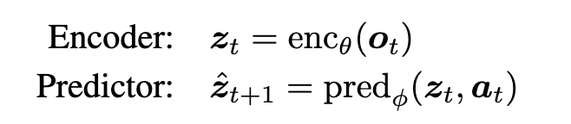
LEWM
The encoder is implemented as a Vision Transformer (ViT). The projection step maps the [CLS] token embedding into a new representation space using a 1-layer MLP with Batch Normalization.
The predictor is a transformer with 6 layers, 16 attention heads, and 10% dropout (∼10M parameters). The predictor is also followed by a projector network with the same implementation as the one used for the encoder.

Slide 16

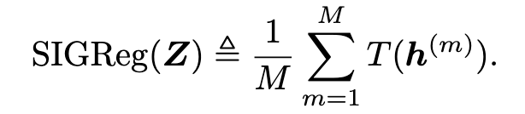

LEWM
The prediction loss Lpred (teacher-forcing) computes the error between the predicted embedding of consecutive time-steps:
SIGReg circumvents this limitation by projecting embeddings onto M random unit-norm directions u(m) ∈ Sd−1 and optimizing the univariate EppsPulley [38] test statistic T (·) along the resulting one-dimensional projections h(m) = Zu(m),
Notes:
T(h(m))：Epps–Pulley test statistic，一个一维正态性检验统计量。

Slide 17
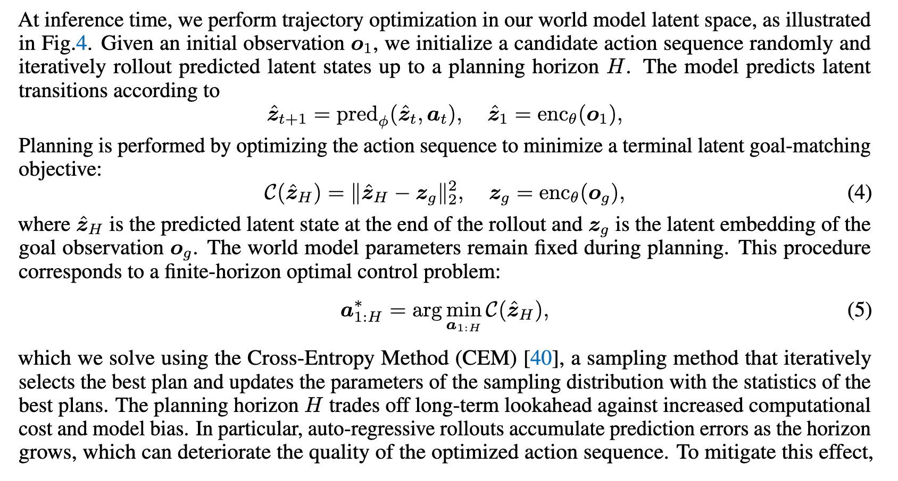
LEWM
Notes:
T(h(m))：Epps–Pulley test statistic，一个一维正态性检验统计量。

Slide 18
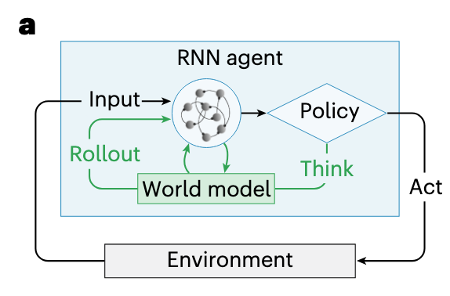
Proposal
1.设计一套合理的数据集，可以表达multitask SWM任务，并且这套任务应该倾向出有一套完整schema可以去复用
2.参考LEWM设计合理的encoder和decoder，确保latent space可解释，可分析，不被过大的正则化影响，且需要考虑如何在此基础上加入Working memory的交互，从而能维持信息
3.选择RL/其他loss办法，设计一种可以完成SWM任务的预测算法，并要求考虑到整体时序过程，选择合适的衰减办法，确保模型会充分考虑所有/部分/几个时间段的潜空间动力学

